Slide 1
B.E. 11 「～するとよい」「～しなければならない」
❶ You should go to this exhibition.
この展覧会に行くといいよ．
❷ You must see these pictures.
これらの絵は見ておかないといけないよ．

Slide 2
「～するとよい，～すべきである」はshouldを，「～しなければならない」はmustを用いて表します．
mustのほうが，shouldよりも意味が強くなります．

Slide 3
▶「～しなければならない」は〈have to〉を用いて表す こともできます．
We had to visit him yesterday.
〔過去を表す場合は×must〕

Slide 4
▶must not［mustn’t］は「～してはいけない」〔禁止〕， 〈do not[don’t] have to〉は「～しなくてもよい」〔不必 要〕の意味になります．

Slide 5
ある映画を見るように
①勧めるとき ②強く勧めるとき
The movie is great.
① You .
② You .
should see[watch] it
must see[watch] it

Slide 6
(2) 生徒が職員室への入室を禁止されているとき
Students the
staff room this week.
must not[mustn’t] enter

Slide 7
B.E. 12 「～だったにちがいない」「 ～すべきだったのに」など
❸ Tom may have arrived there early.
トムはそこに早く着いたのかもしれない．
❹ He must have enjoyed the exhibition.
彼はその展覧会を楽しんだにちがいない．
❺ We should have visited it last week.
私たちは先週そこを訪れるべきだった．

Slide 8
過去のことについて，「～だった[した]にちがいない╱かもしれない」と推量する場合は〈must[may] have＋過去分詞〉で表します．また，〈should＋have＋過去分詞〉は，「～すべきだったのに」と過去のことについての後悔などを表します．

Slide 9
▶ Sam was with us last night, so you
can’t have seen him at the station.
〔〜したはずがない〕

Slide 10
Saya looked ill last week.
She a cold.
〔〜したかもしれない〕
(2) The drama was exciting.
You it.
〔〜すべきだったのに〕
may have had
should have watched[seen]

Slide 11
(3) Jim didn’t answer the phone.
He sleeping.
〔〜していたにちがいない〕
must have been

Slide 12
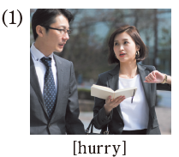
A Look at the pictures and complete the sentences.
Use the words below. 〔(1) → B.E. 11〕
*should, must, have toを使ってみよう．
We .
The meeting will begin soon.
must[have to, should] hurry

Slide 13
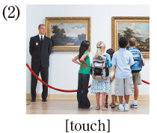
A Look at the pictures and complete the sentences.
Use the words below. 〔(2) → B.E. 11〕
*should, must, have toを使ってみよう．
(2) You the museum
exhibits.
mustn’t[shouldn’t] touch

Slide 14
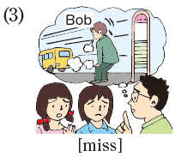
A Look at the pictures and complete the sentences.
Use the words below. 〔(3) → B.E. 12〕
*〈may[must, should]+have+過去分詞〉を使ってみよう．
(3) Bob hasn’t arrived yet.
the bus.
He may[must] have missed

Slide 15
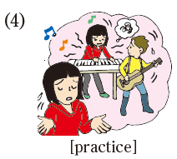
A Look at the pictures and complete the sentences.
Use the words below. 〔(4) → B.E. 12〕
*〈may[must, should]+have+過去分詞〉を使ってみよう．
(4) more
before the concert.
I[The girl] should have practiced

Slide 16
B Express yourself!
▶ Tell what happened and give your conclusion.
Ex.) John said he wanted to read the magazine, so
he may have bought a copy.
She had walked about five kilometers, so she must
have been very tired.
I had a very bad score on the exam. I should have
studied harder.

Slide 17
1 Listen to the dialog between Lily and Takumi.
Write down some key words.

Slide 18
2 Work in pairs. Refer to 1 and reproduce the dialog.
Lily: to Ueno Zoo?
Takumi: No, there.
L: It’s great. You .
T: in the zoo do you like
best?
L: I love the pandas. You .
They are so cute.
T: Pandas? I’ve always !
Have you ever been
I’ve never been
should go sometime
Which of the animals
must see them
wanted to see a panda

Slide 19
3 Work in groups.
a Students A and B will make a dialog of their own
similar to the one in 2 and present it to students
C and D.
b C and D will ask questions or make comments
about the dialog. (Then switch roles.)

