Slide 1
REPRODUCTION
※製品版では，写真・図版等の資料も表示されます。
STEP 1
Preparing
Use the outlines below to prepare for your presentation.

Slide 2
REPRODUCTION
Part 1
OUTLINE
※製品版では，Part 2以降のスライドも表示できます。
a peace activist from Rwanda
Marie Louise Kambenga is ¹ .
・In 1993, she ² .
came to Fukushima as a trainee to study dressmaking
was a completely new experience for her
・Life in Japan ³ .
・She was amazed ⁴ .
when she saw an elderly woman reading a newspaper
・She was impressed ⁵ .
with Japan’s educational system (, especially free public education for all children)
[ activist, Fukushima, trainee, experience, read, educational ]

Slide 3
REPRODUCTION
STEP 2
Retelling
Make a group of four people. Take turns retelling each part of this lesson.
Part 1
Part 2
Part 3
Part 4
製品版では
リテリングに
有用な写真等が
表示されます
写真・イラスト
写真・イラスト
写真・イラスト

Slide 4
REPRODUCTION
Part 1
※製品版では，Part 2以降のスライドも表示できます。
What was surprising for Louise in Japan?
[ activist, Fukushima, trainee, experience, read, educational ]
Marie Louise Kambenga is a peace activist from Rwanda. In 1993, she came to Fukushima as a trainee to study dressmaking. Life in Japan was a completely new experience for her. For example, she was amazed when she saw an elderly woman reading a newspaper. She was also impressed with Japan’s educational system, especially free public education for all children.
製品版では
リテリングに
有用な写真等が
表示されます

Slide 5
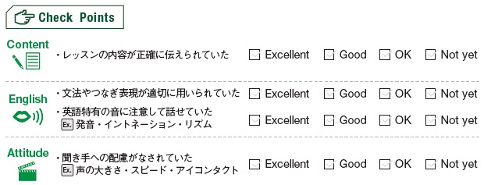
REPRODUCTION

Slide 6
REPRODUCTION
STEP 3
Expressing
Express your opinions on one of the following questions in more than 40 words.
Questions
A. What can you do to help people who are suffering?
B. In addition to education, what do you think is necessary to prevent future wars?
C. Any other ideas?

Slide 7
REPRODUCTION
Model
Why do you think people continue to fight against each other?
― It seems to me that religion is a big reason. Some people believe that only their religion is the correct one and do not recognize others at all. I think this has resulted in fighting or even wars around the world. (41 words)

Slide 8
REPRODUCTION
Expressions
【推測する】
I guess [suppose] …（…だと推測する）
It seems to me that …（私には…だと思われる）
～ may [might] do （～は…するかもしれない）

Slide 9
REPRODUCTION
※製品版では，A問題以外のスライドも表示できます。
A. What can you do to help people who are suffering?
（解答例）
I think we should take some actions to help people who are suffering. For example, we can make a donation to support refugees. We can also post articles about them on SNS. Our small actions may lead to a big change in the world. (44 words)

