Slide 1

Lesson 5 A Journey to Peace Part 1
❶ ¹ Have you ever heard of Rwanda? ² It is a country with great natural beauty in central Africa. ³ Marie Louise Kambenga, a peace activist, is from Rwanda. ⁴ She was the only girl who graduated from high school in her village. ⁵ She studied home economics, and after graduation, became a dressmaking teacher. ⁶ In her school, there was a Japanese volunteer. ⁷ She recommended Louise as a trainee in Japan.

Slide 2
Lesson 5 A Journey to Peace Part 1
Phrase Reading
❶ ¹ Have you ever heard of Rwanda? // ² It is a country with great natural beauty / in central Africa. // ³ Marie Louise Kambenga, / a peace activist, / is from Rwanda. // ⁴ She was the only girl / who graduated from high school / in her village. // ⁵ She studied home economics, / and after graduation, / became a dressmaking teacher. // ⁶ In her school, / there was a Japanese volunteer. // ⁷ She recommended Louise / as a trainee in Japan. //

Slide 3
Lesson 5 A Journey to Peace Part 1
❶ ¹ ルワンダについて聞いたことがあるだろうか。² それは中央アフリカにある自然がとても美しい国だ。³ 平和活動家であるマリールイズ・カンベンガは，ルワンダの出身だ。⁴ 彼女は村で高校を卒業した唯一の女性だった。⁵ 彼女は家政学を学び，卒業後は洋裁の教師になった。⁶ 彼女の学校には，日本人ボランティアがいた。⁷ 彼女はルイズを日本での研修生として推薦してくれた。

Slide 4
Lesson 5 A Journey to Peace Part 1
❷ ⁸ In 1993, Louise came to Fukushima as a trainee to study dressmaking. ⁹ Living with a host family in Japan was a completely new experience for her. ¹⁰ Louise was really amazed when she saw an elderly woman reading a newspaper. ¹¹ She had never seen such a thing! ¹² Louise was also impressed with Japan’s educational system, especially free public education for all children. ¹³ In Rwanda, many poor children could not go to school. ¹⁴ In 1994, after an interesting 10-month experience, Louise returned to her husband and children in Rwanda.

Slide 5
Lesson 5 A Journey to Peace Part 1
Phrase Reading
❷ ⁸ In 1993, / Louise came to Fukushima / as a trainee / to study dressmaking. // ⁹ Living with a host family in Japan / was a completely new experience / for her. // ¹⁰ Louise was really amazed / when she saw an elderly woman / reading a newspaper. // ¹¹ She had never seen / such a thing! // ¹² Louise was also impressed / with Japan’s educational system, / especially free public education / for all children. // ¹³ In Rwanda, / many poor children could not go to school. // ¹⁴ In 1994, / after an interesting 10-month experience, / Louise returned to her husband and children / in Rwanda. //

Slide 6
Lesson 5 A Journey to Peace Part 1
❷ ⁸ 1993年，ルイズは洋裁を学ぶために研修生として福島に来た。⁹ 日本でホストファミリーと暮らすことは彼女にとってまったく新しい経験だった。¹⁰ ルイズは年配の女性が新聞を読んでいるのを見て，とても驚嘆した。¹¹ 彼女はそのようなものをまったく見たことがなかったのだ！¹² ルイズはまた，日本の教育システム，特にすべての子どもたちへの無料の義務教育に感銘を受けた。¹³ ルワンダでは，多くの貧乏な子どもたちは学校へ行けなかった。¹⁴ 1994年，興味深い10か月の経験を終えて，ルイズはルワンダの夫と子どもたちの元へ帰った。

Slide 7

Lesson 5 A Journey to Peace Part 1
Listening Quiz
サンプルのため，音声再生はできません。
(1) T / F
In Louise’s village, there were a lot of girls who graduated from high school.
(2) T / F
Louise came to Japan to study dressmaking.
(3) T / F
Louise never returned to her family in Rwanda.

Slide 8
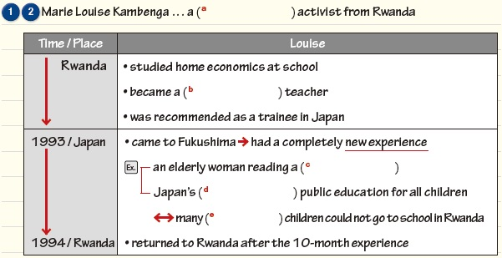
Lesson 5 A Journey to Peace Part 1
Fill in the blanks below to complete the outline.
LOGIC FLOW
peace
dressmaking
newspaper
free
poor

Slide 9
Lesson 5 A Journey to Peace Part 1
Answer the questions. Check your answers with your partner.
TASK 1
(1) What is Rwanda like?
It is a country with great natural beauty.
(2) What did a Japanese volunteer do for Louise?
(2) What did a Japanese volunteer do for Louise?
(2) What did a Japanese volunteer do for Louise?
She recommended Louise [her] as a trainee in Japan.
(3) How was Louise’s life in Japan?
(3) How was Louise’s life in Japan?
It was a completely new experience for her.
(4) Why was Louise impressed with Japan’s free public education?
(It was) Because, in Rwanda, many poor children could not go to school.

Slide 10
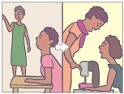
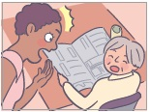
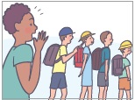
Lesson 5 A Journey to Peace Part 1
Describe the pictures below to your partner.
TASK 2
(1) Louise studied …
(2) Louise …
(3) Louise …
[ home economics, dressmaking ]
[ amaze, elderly woman ]
[ impress, educational ]
(1) Louise studied home economics, and after graduation, became a dressmaking teacher.
(2) Louise was (really) amazed when she saw an elderly woman reading a newspaper.
(3) Louise was (also) impressed with Japan’s educational system, especially free public
education for all children.

Slide 11
Lesson 5 A Journey to Peace Part 1
Your Opinion
In Rwanda, many children could not go to school for economic reasons. What other reasons can you think of?
I think parents’ lack of awareness about education is a big reason. In some African countries, many parents do not realize the value of education. They make their children work instead of going to school.
(35 words)

