Slide 1
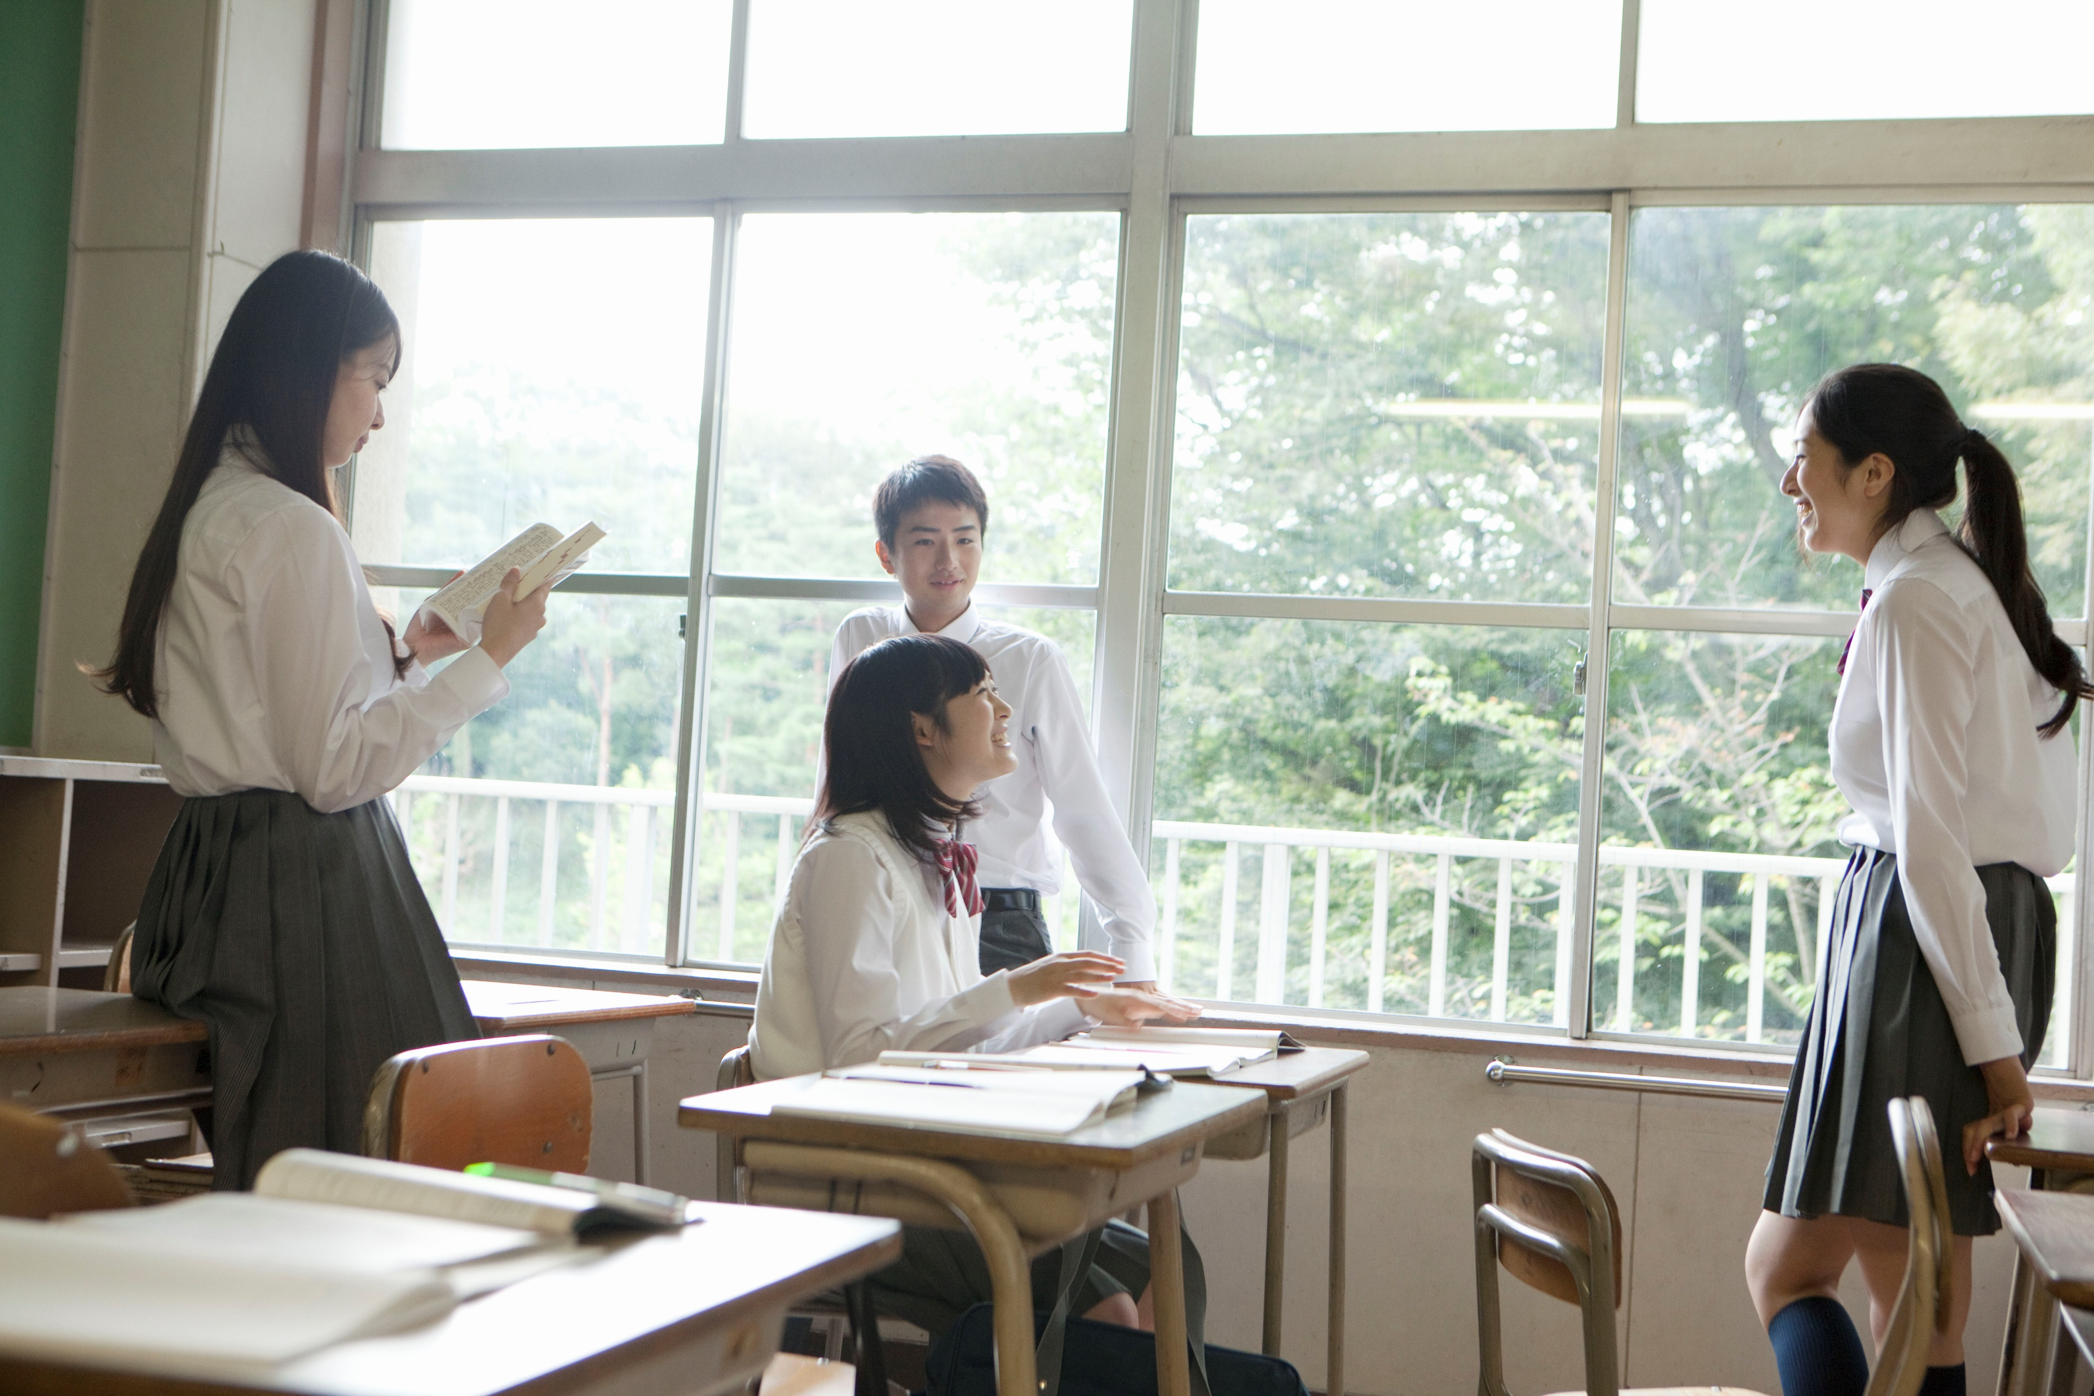
Are you all enjoying your new school life?

Slide 2
However, you may be busy
with your club activities.

Slide 3
Some of you may be trying to study too much.

Slide 4
First of all, get enough sleep.

Slide 5
Meals are important too.

Slide 6
Have breakfast every day,
even if you don't think you have time.

Slide 7
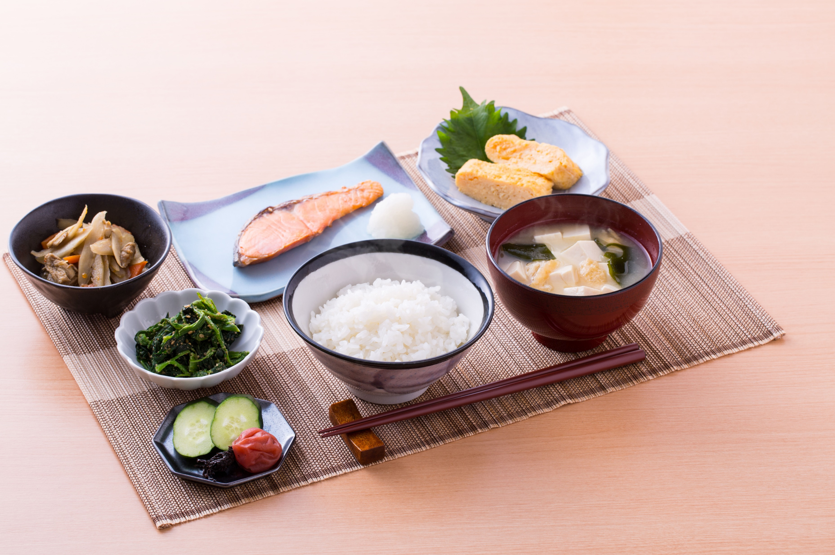
Start your day with breakfast!

Slide 8
Let's think about breakfast in this lesson.

