Slide 1
LESSON 8
Kazu Hiro:
In Pursuit of a Dream

Slide 2

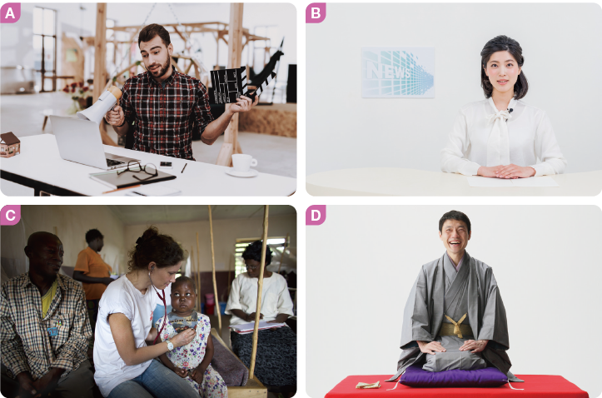
1. Look at Pictures A to D. Listen and choose the correct picture for each description.

Slide 3
1. I am very interested in making films. I want to work in Hollywood.
2. I want to help many people in hard situations around the world.
3. I act in a one-man show. I want to make people laugh by telling funny stories.
4. I read the news on TV and explain various events.
A
C
D
B

