Slide 1


Have you decided on your future profession?

Slide 2
It seems that many people are influenced by the people around them when they decide on their future job.

Slide 3
Or they may see television or other media
and think they'd like to get into that kind of work.

Slide 4
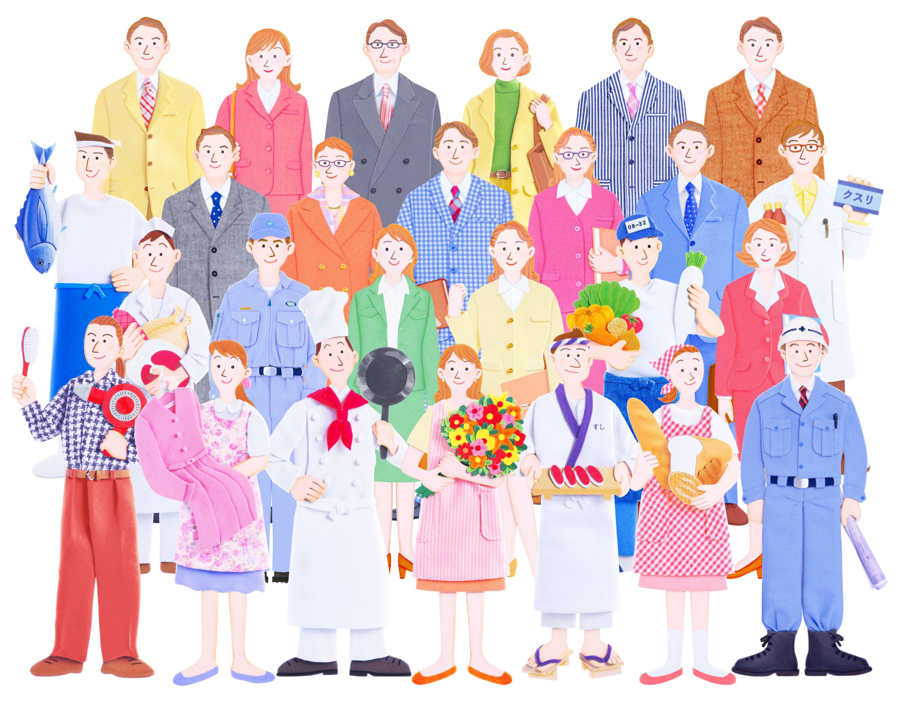
When it comes to work, what do you value?

Slide 5
Is it a stable income?

Slide 6
Do you want to help others?

Slide 7
Do you want to do something you like?

Slide 8
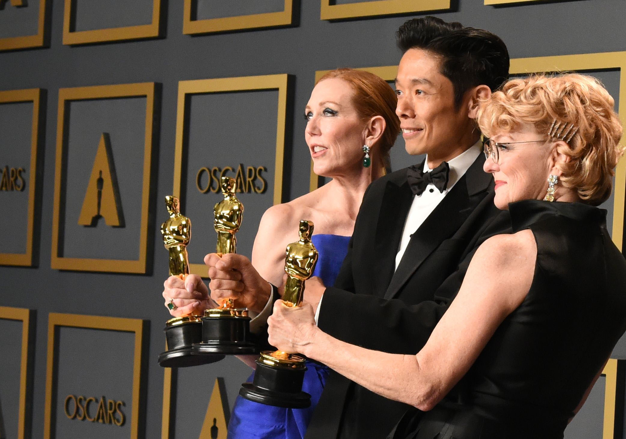
Kazu Hiro came across his future job
when he was a high school student.

Slide 9
Let's read about how he made his dream come true.

