Slide 1
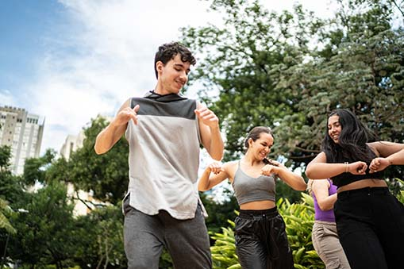

When do you feel happy?

Slide 2
Do you feel happy when you dance to music?

Slide 3
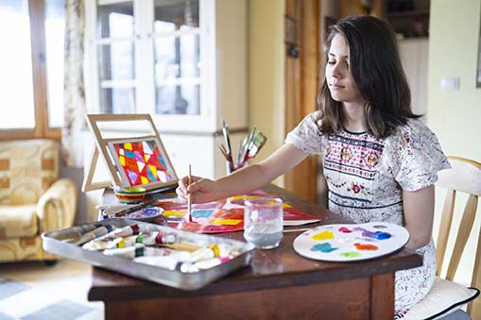
Do you feel happy when you draw pictures?

Slide 4
People enjoy themselves in many ways.

Slide 5
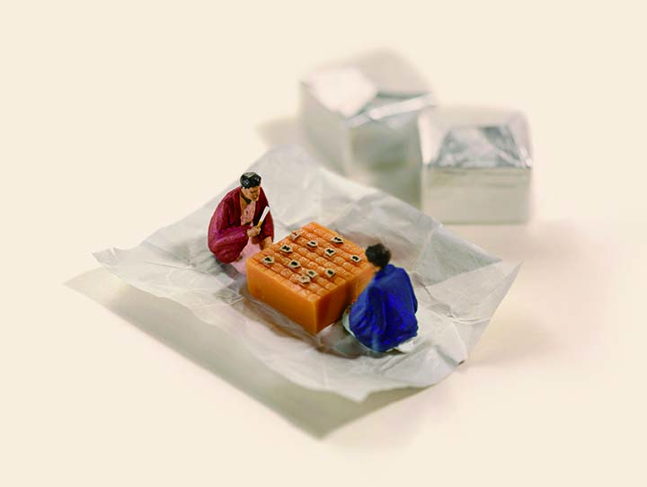
An artist, Tanaka Tatsuya, enjoys his work very much.

Slide 6
What does he make every day?

Slide 7
What does he use for his works?

Slide 8
Let’s take a look in this lesson.

