Slide 1
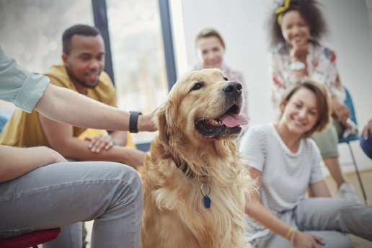
Do you know about facility dogs?

Slide 2
They are a type of therapy dog.

Slide 3
They usually work with people in hospitals and other facilities.

Slide 4
In Japan, facility dogs started to work in 2009.

Slide 5
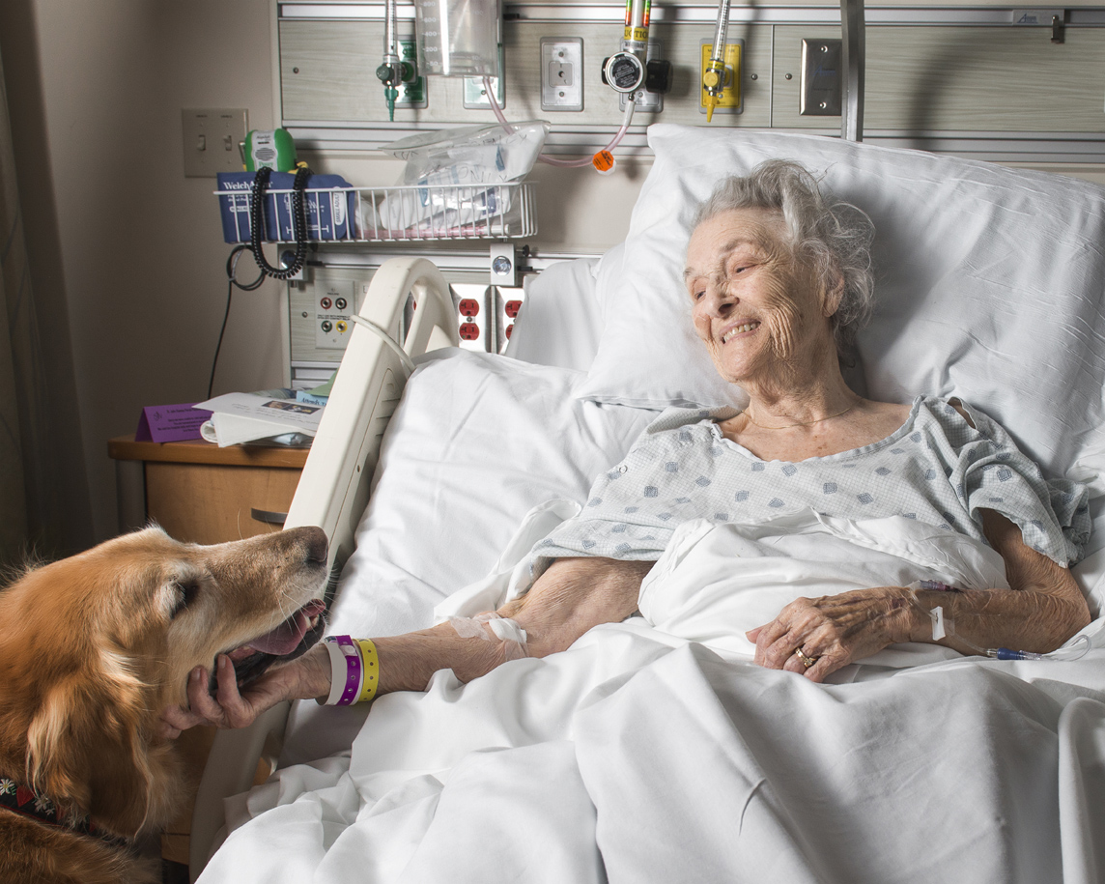
Dogs have a special power over humans.

Slide 6
They can make people smile.

Slide 7
They can heal the feelings of people with certain problems.

Slide 8
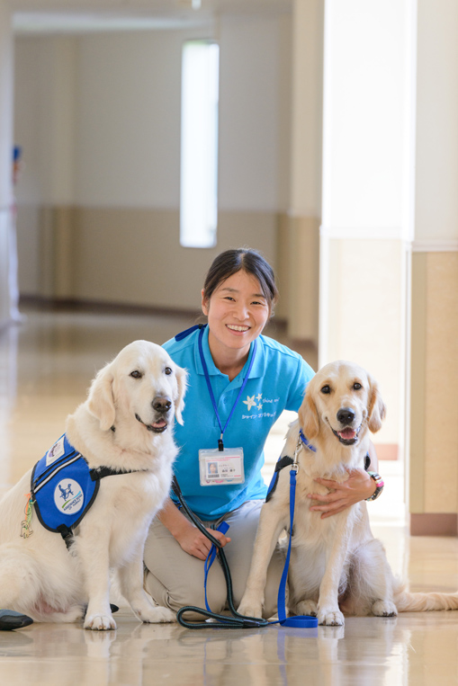
Let’s learn about facility dogs and their handlers in this lesson.

